Slide 1
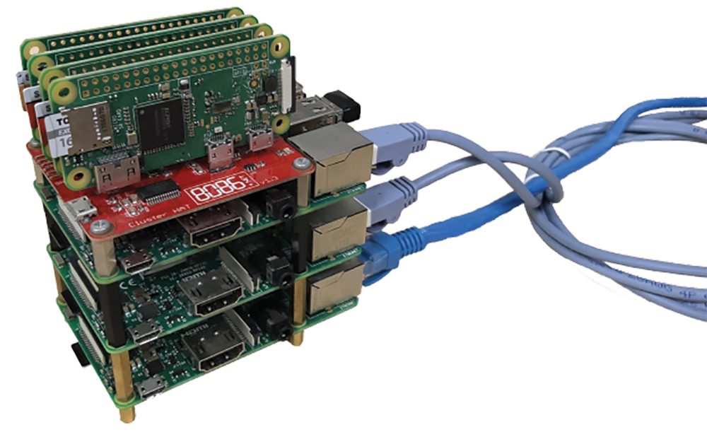
Prowler
Distributed Network Vulnerability Scanner
Timothy Liu
Wong Chi Seng
Faith See
SINGAPORE UNIVERSITY OF TECHNOLOGY AND DESIGN
Prowler
Distributed Network Vulnerability Scanner
Timothy Liu
Wong Chi Seng
Faith See
SINGAPORE UNIVERSITY OF TECHNOLOGY AND DESIGN
Often, security breaches are not due to hackers breaking through layers of tough security. They happen because someone didn’t change their default passwords.
Prowler finds weakly secured devices on networks and notifies the administrator.
Often, security breaches are not due to hackers breaking through layers of tough security. They happen because someone didn’t change their default passwords.
Prowler finds weakly secured devices on networks and notifies the administrator.
PING
Device
online
NMAP
Fingerprint
EVAL
Report
DASHBOARD
PING
Device
online
NMAP
Fingerprint
EVAL
Report
DASHBOARD
https://tlkh.github.io/prowler
https://tlkh.github.io/prowler

Slide 2
Capabilities
Scan a network (a particular subnet or a list of IP addresses) for all IP addresses associated with active network devices
Determine the type of devicing using fingerprinting
Determine if there are any open ports on the device
Associate the ports with common services
Test devices against a dictionary of factory default and common credentials
Notify users of security vulnerabilities through an dashboard (above).
Capabilities
Scan a network (a particular subnet or a list of IP addresses) for all IP addresses associated with active network devices
Determine the type of devicing using fingerprinting
Determine if there are any open ports on the device
Associate the ports with common services
Test devices against a dictionary of factory default and common credentials
Notify users of security vulnerabilities through an dashboard (above).

